Slide 1
Computer Vision
Fall 2017
Problem Set #2
Zhi Zhang
zhizhang@gatech.edu
Computer Vision @ GT

Slide 2
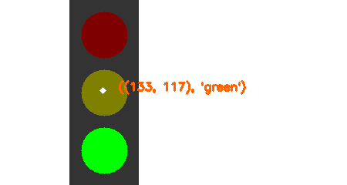
Traffic Light Detection
Coordinates and State
ps2-1-a-1.png

Slide 3
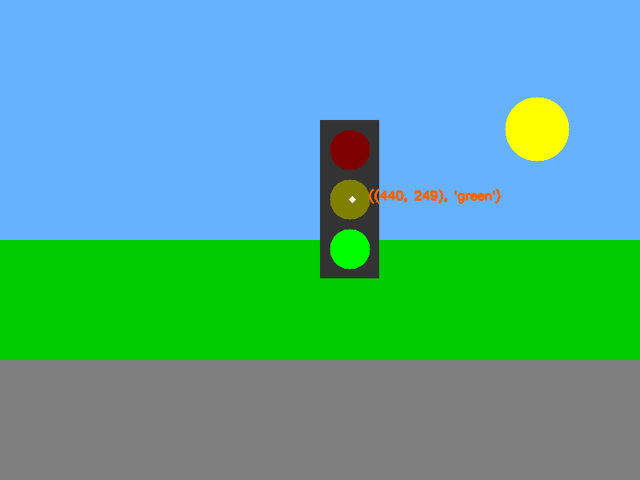
Traffic Light Detection
Coordinates and State
ps2-1-a-2.png

Slide 4
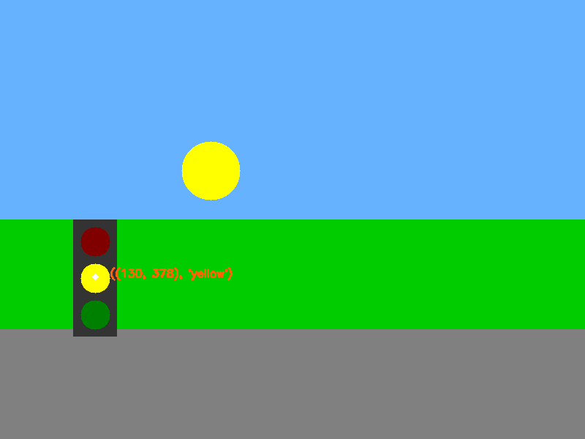
Traffic Light Detection
Coordinates and State
ps2-1-a-3.png

Slide 5

Traffic Light Detection
Coordinates and State
ps2-1-a-4.png

Slide 6
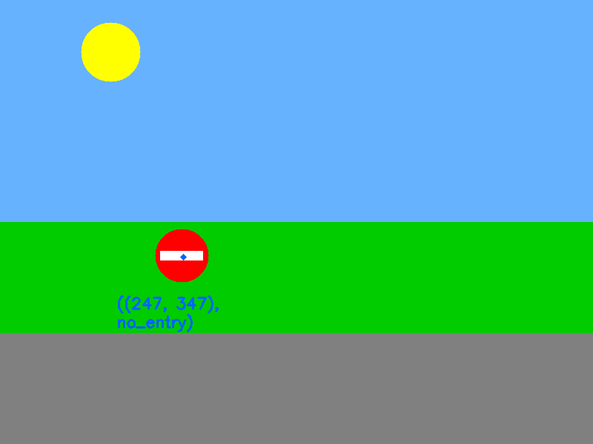
Traffic Sign Detection - Do not enter
Coordinates
ps2-2-a-1.png

Slide 7
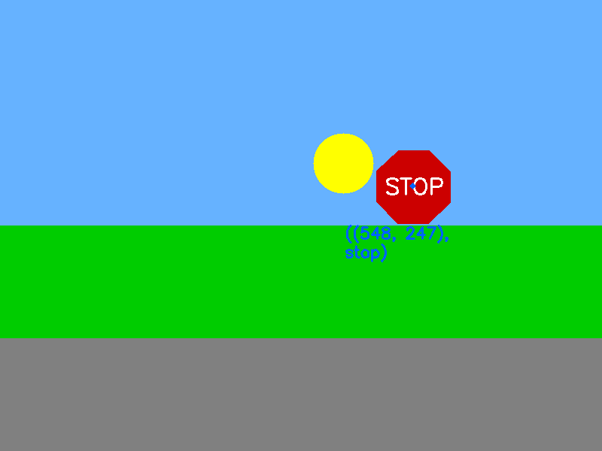
Traffic Sign Detection - Stop
Coordinates
ps2-2-a-2.png

Slide 8
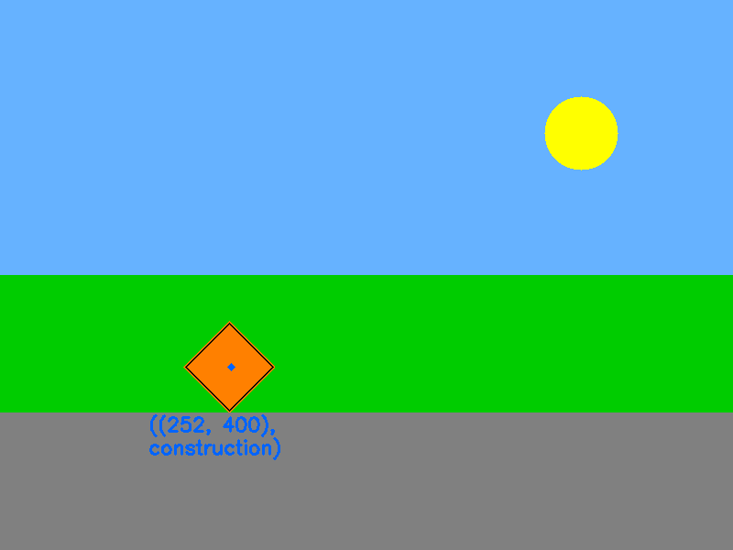
Traffic Sign Detection - Construction
Coordinates
ps2-2-a-3.png

Slide 9

Traffic Sign Detection - Warning
Coordinates
ps2-2-a-4.png

Slide 10
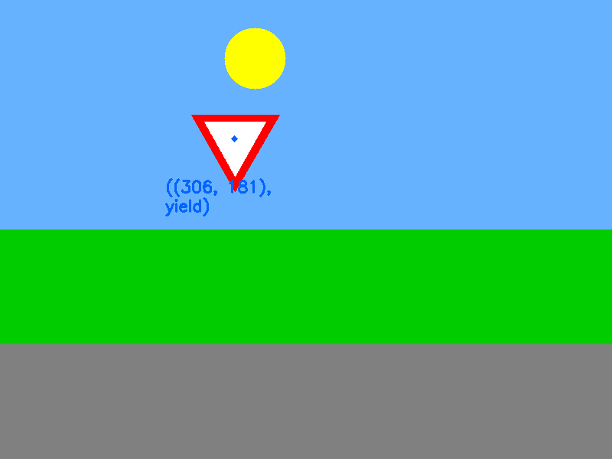
Traffic Sign Detection - Yield
Coordinates
ps2-2-a-5.png

Slide 11
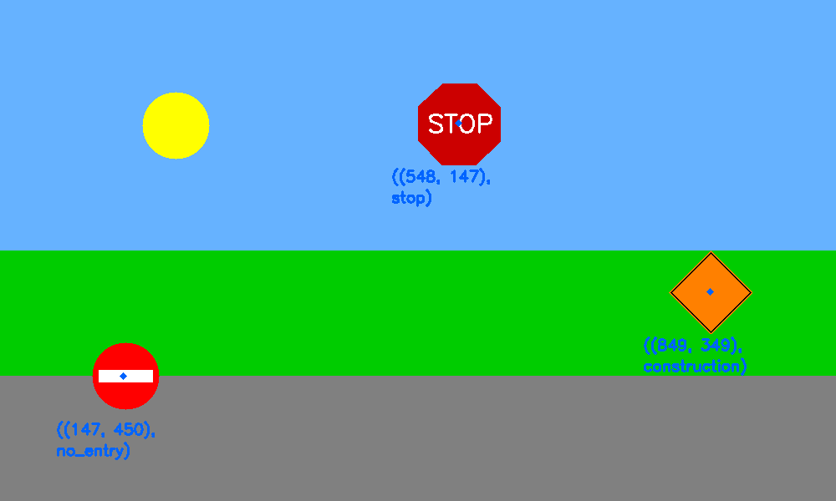
Multiple sign detection
Coordinates and Name
ps2-3-a-1.png

Slide 12
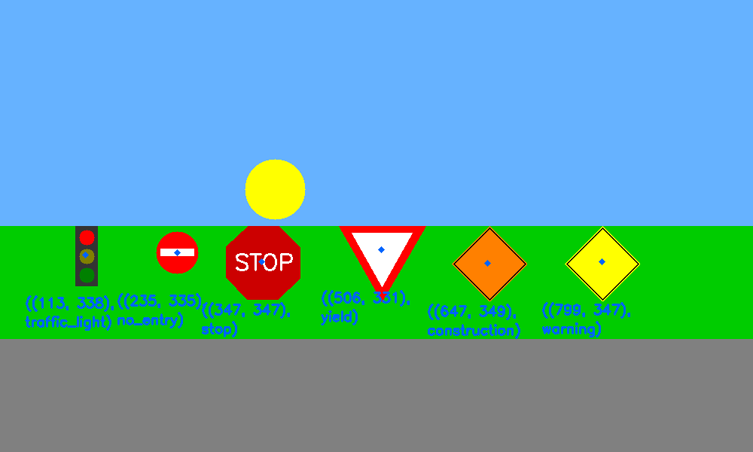
Multiple sign detection
Coordinates and Name
ps2-3-a-2.png

Slide 13
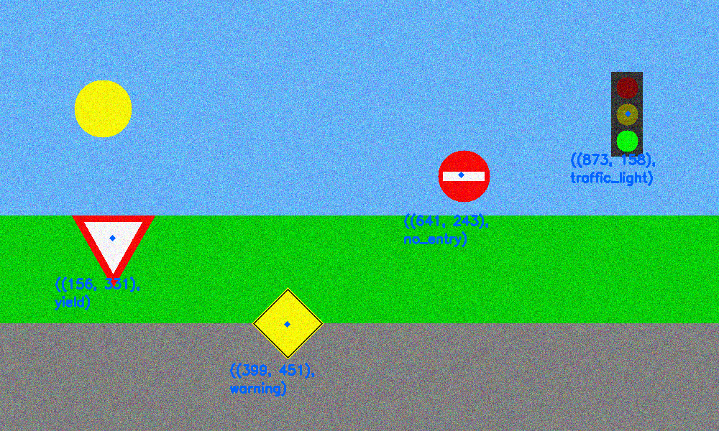
Multiple sign detection with noise
Coordinates and Name
ps2-4-a-1.png

Slide 14
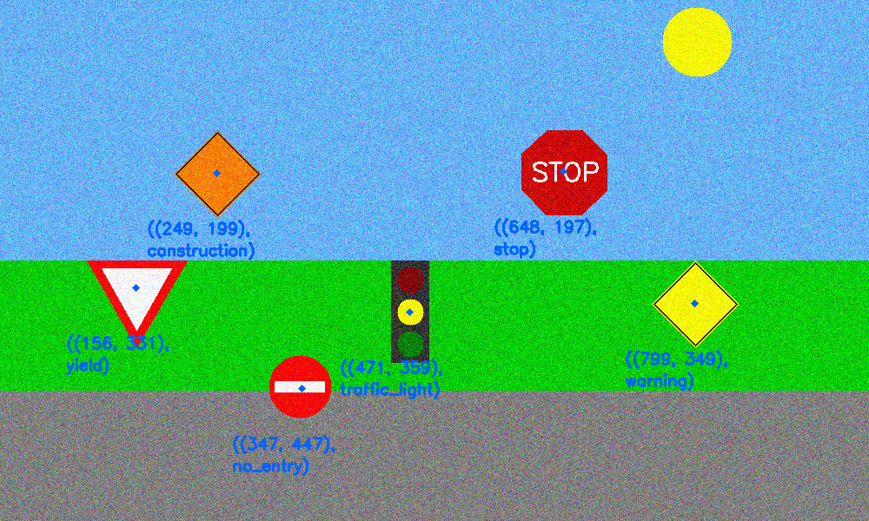
Multiple sign detection with noise
Coordinates and Name
ps2-4-a-2.png

Slide 15
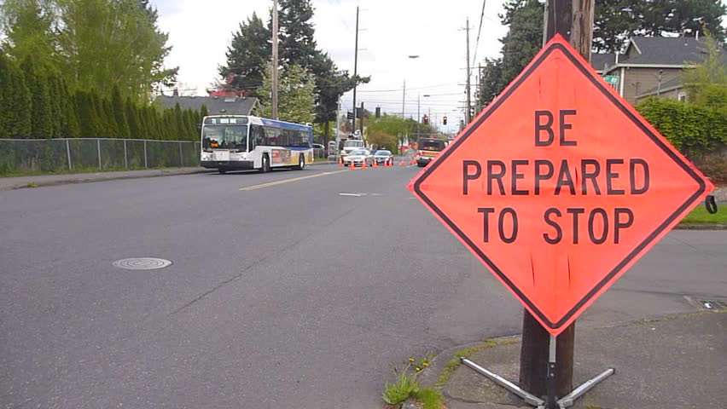
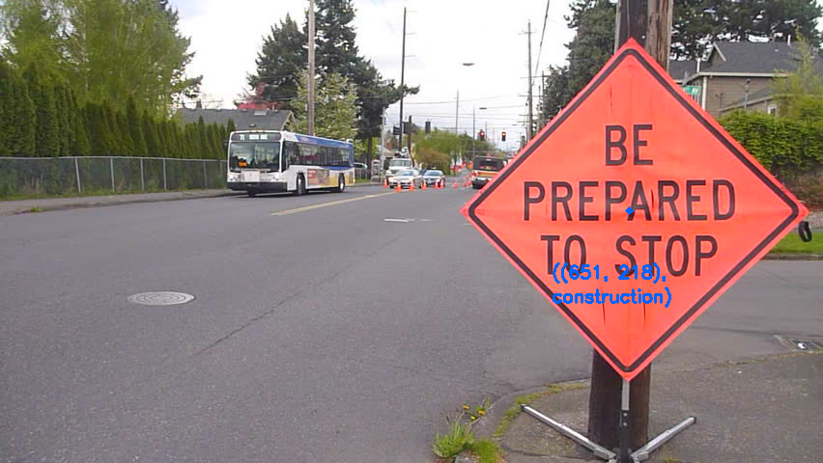
Challenge Problem
Coordinates and Name
Input image: img-5-a-1.png
Output image: ps2-5-a-1.png

Slide 16
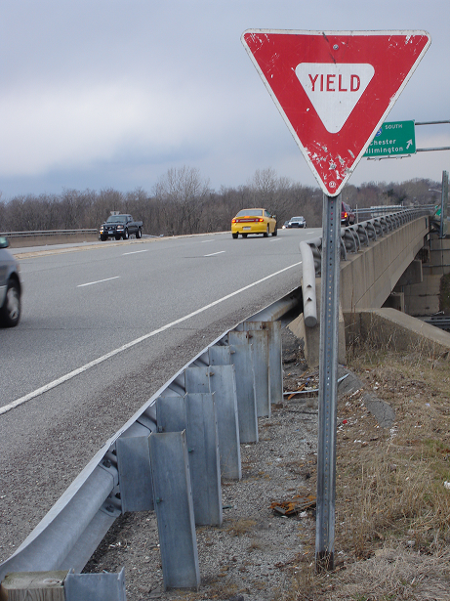
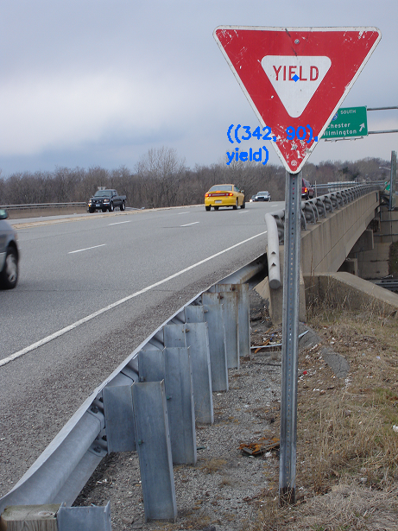
Challenge Problem
Coordinates and Name
Input image: img-5-a-2.png
Output image: ps2-5-a-2.png

Slide 17
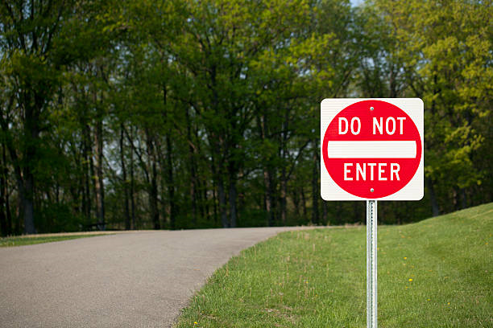
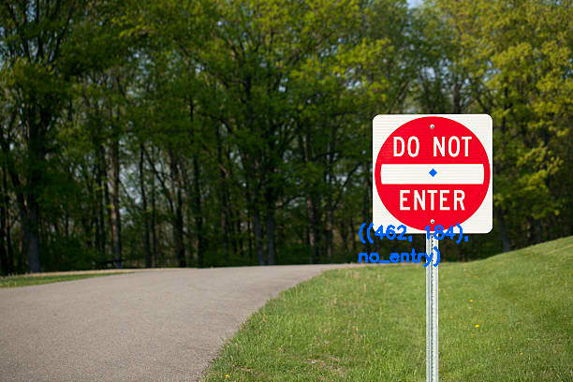
Challenge Problem
Coordinates and Name
Input image: img-5-a-3.png
Output image: ps2-5-a-3.png

Slide 18
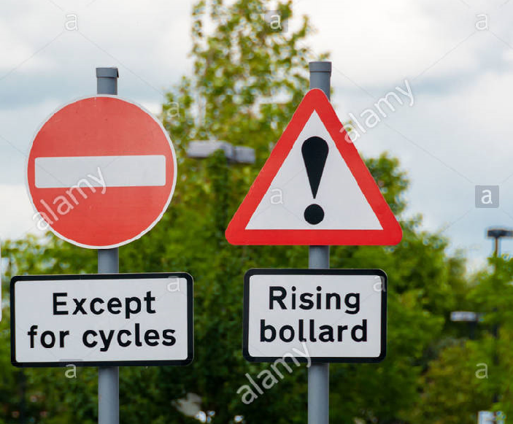

Challenge Problem
Coordinates and Name
Input image: img-5-b-1.png
Output image: ps2-5-b-1.png

Slide 19
Challenge Problem
Describe what you had to do to adapt your code for this task. How does the difference between simulated and real-world images affect your method? If you used other functions/methods, explain why that was better(or why your previous implementation did not work)
The things I have to adapt my code for real-world images are:
To expand the Hue value range for the target object. In order to differentiate with other objects, the first step I did was to use the Hue value range to extract the target traffic sign. In real-world images, colors are not always presenting as they should be, for example, my img-5-a-1.png has the construction sign which falls into the red color range instead of orange, if I only check the orange, then it won’t show up, so I have to expand the color range to be the warm tune colors including both orange and red.
To give more variations to check angles between edges. My standard approach to use HoughLines to locate a polygon traffic sign is: generate HoughLines – Using known angles to select lines – Calculate intersection points between lines – further selecting objects by using other conditions (equal side length). Real-world images sometimes are skewed compared to simulated images, so the angles are not exactly 60 degree for a yield sign and 90 degree for a construction sign, so I give more variation spaces to include more possible situations.
To apply filters to smooth the image. Real-world images contain more objects than the simulated images, these objects (lines or circles) can cause false positives, so I used the cv2.GaussianBlur() method to smooth the image to reduce the possibilities of including those false positive objects.

